Slide 1
Unit – 3
Switched Communication Networks

Slide 2
Switching Techniques
In large networks there might be multiple paths linking sender and receiver. Information may be switched as it travels through various communication channels. There are three typical switching techniques available for digital traffic.
  Circuit Switching
  Message Switching
  Packet Switching

Slide 3

Switched network
A switched network consists of a series of interlinked nodes, called switches. Switches are devices capable of creating temporary connections between two or more devices linked to the switch. In a switched network, some of these nodes are connected to the end systems (computers or telephones, for example). Others are used only for routing.

Slide 4

Taxonomy of switched networks

Slide 5
CIRCUIT-SWITCHED NETWORKS
A circuit-switched network consists of a set of switches connected by physical links. A connection between two stations is a dedicated path made of one or more links. However, each connection uses only one dedicated channel on each link. Each link is normally divided into n channels by using FDM or TDM.
Topics discussed in this section:
Three Phases
Efficiency
Delay
Circuit-Switched Technology in Telephone Networks

Slide 6

Note
A circuit-switched network is made of a set of switches connected by physical links, in which each link is
divided into n channels.

Slide 7
Circuit Switching
Circuit switching is a technique that directly connects the sender and the receiver in an unbroken path.
Telephone switching equipment, for example, establishes a path that connects the caller's telephone to the receiver's telephone by making a physical connection.
In this type of switching technique, once a connection is established, a dedicated path exists between both ends until the connection is terminated.
Routing decisions must be made when the circuit is first established, but decisions cannot be made after that time.

Slide 8
Circuit Switching
Circuit switching networks operate almost the same way as the telephone system works.
A complete end-to-end path must exist before communication can take place.
The computer initiating the data transfer must ask for a connection to the destination.
Before the establishment of the connection, the destination must send the acknowledge to the source node to indicate that it is ready and willing to send/receive data.

Slide 9
Circuit switching
Advantages:
  The communication channel (once established) is dedicated.
Disadvantages:
  Possible long wait to establish a connection, (10 seconds,
  more on long- distance or international calls.) during which
  no data can be transmitted.
  More expensive than any other switching techniques,
  because a dedicated path is required for each connection.
  Inefficient use of the communication channel, because the
  channel is not used when the connected systems are not
  using it.

Slide 10
A trivial circuit-switched network
The end systems, such as computers or telephones, are directly connected to a switch. We have shown only two end systems for simplicity.
When end system A needs to communicate with end system M, system A needs to request a connection to M that must be accepted by all switches as well as by M itself. This is called the setup phase; a circuit (channel) is reserved on each link, and the combination of circuits or channels defines the dedicated path.
After the dedicated path made of connected circuits (channels) is established, data transfer can take place. After all data have been transferred, the circuits are tom down.

Slide 11

A trivial circuit-switched network

Slide 12
A trivial circuit-switched network
Circuit switching takes place at the physical layer.
Before starting communication, the stations must make a reservation for the resources to be used during the communication. These resources, such as channels (bandwidth in FDM and time slots in TDM), switch buffers, switch processing time, and switch input/output ports, must remain dedicated during the entire duration of data transfer until the teardown phase.
Data transferred between the two stations are not packetized (physical layer transfer of the signal). The data are a continuous flow sent by the source station and received by the destination station, although there may be periods of silence.
There is no addressing involved during data transfer. The switches route the data based on their occupied band (FDM) or time slot (TDM). Of course, there is end-to end addressing used during the setup phase.

Slide 13
Note
In circuit switching, the resources need to be reserved during the setup phase;
the resources remain dedicated for the entire duration of data transfer until the teardown phase.

Slide 14
Example 8.1
As a trivial example, let us use a circuit-switched network to connect eight telephones in a small area. Communication is through 4-kHz voice channels. We assume that each link uses FDM to connect a maximum of two voice channels. The bandwidth of each link is then 8 kHz. Figure 8.4 shows the situation. Telephone 1 is connected to telephone 7; 2 to 5; 3 to 8; and 4 to 6. Of course the situation may change when new connections are made. The switch controls the connections.

Slide 15

Figure 8.4 Circuit-switched network used in Example 8.1

Slide 16
Example 8.2
As another example, consider a circuit-switched network that connects computers in two remote offices of a private company. The offices are connected using a T-1 line leased from a communication service provider. There are two 4 × 8 (4 inputs and 8 outputs) switches in this network. For each switch, four output ports are folded into the input ports to allow communication between computers in the same office. Four other output ports allow communication between the two offices. Figure 8.5 shows the situation.

Slide 17

Figure 8.5 Circuit-switched network used in Example 8.2

Slide 18
Circuit-switched network
Three Phases
The actual communication in a circuit-switched network requires three phases: connection setup, data transfer, and connection teardown.
Setup Phase
Before the two parties (or multiple parties in a conference call) can communicate, a dedicated circuit (combination of channels in links) needs to be established. The end systems are normally connected through dedicated lines to the switches, so connection setup means creating dedicated channels between the switches.
Data Transfer Phase
After the establishment of the dedicated circuit (channels), the two parties can transfer data.
Teardown Phase
When one of the parties needs to disconnect, a signal is sent to each switch to release the resources.

Slide 19
Circuit-switched network
Efficiency
Circuit-switched networks are not as efficient as the other two types of networks because resources are allocated during the entire duration of the connection.
These resources are unavailable to other connections. In a telephone network, people normally terminate the communication when they have finished their conversation.
However, in computer networks, a computer can be connected to another computer even if there is no activity for a long time. In this case, allowing resources to be dedicated means that other connections are deprived.
Delay
The total delay is due to the time needed to create the connection, transfer data, and disconnect the circuit

Slide 20

Figure 8.6 Delay in a circuit-switched network

Slide 21
Note
Switching at the physical layer in the traditional telephone network uses
the circuit-switching approach.

Slide 22
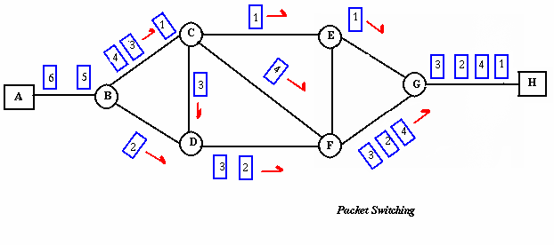
Packet Switching
Packet switching can be seen as a solution that tries to combine the advantages of message and circuit switching and to minimize the disadvantages of both.
There are two methods of packet switching: Datagram and virtual circuit.

Slide 23
Packet Switching
In both packet switching methods, a message is broken into
small parts, called packets.
Each packet is tagged with appropriate source and destination
addresses.
Since packets have a strictly defined maximum length, they
can be stored in main memory instead of disk, therefore access
delay and cost are minimized.
Also the transmission speeds, between nodes, are optimized.
With current technology, packets are generally accepted onto
the network on a first-come, first-served basis. If the network
becomes overloaded, packets are delayed or discarded
(“dropped'').

Slide 24
Packet switching
In packet switching, the analog signal from your phone is converted into a digital data stream. That series of digital bits is then divided into relatively tiny clusters of bits, called packets. Each packet has at its beginning the digital address -- a long number -- to which it is being sent. The system blasts out all those tiny packets, as fast as it can, and they travel across the nation's digital backbone systems to their destination: the telephone, or rather the telephone system, of the person you're calling.
They do not necessarily travel together; they do not travel sequentially. They don't even all travel via the same route. But eventually they arrive at the right point -- that digital address added to the front of each string of digital data -- and at their destination are reassembled into the correct order, then converted to analog form, so your friend can understand what you're saying.

Slide 25
Packet Switching: Datagram
Datagram packet switching is similar to message switching in
that each packet is a self-contained unit with complete addressing information attached.
This allows packets to take a variety of possible paths through the network.
So the packets, each with the same destination address, do not
follow the same route, and they may arrive out of sequence at
the exit point node (or the destination).
Reordering is done at the destination point based on the sequence number of the packets.
It is possible for a packet to be destroyed if one of the nodes on
its way is crashed momentarily. Thus all its queued packets may be lost.

Slide 26
Packet Switching:Virtual Circuit
In the virtual circuit approach, a preplanned route is established
before any data packets are sent.
A logical connection is established when
a sender send a "call request packet" to the receiver and
the receiver send back an acknowledge packet "call accepted
packet" to the sender if the receiver agrees on conversational
parameters.
The conversational parameters can be maximum packet sizes,
path to be taken, and other variables necessary to establish and
maintain the conversation.
Virtual circuits imply acknowledgements, flow control, and error
control, so virtual circuits are reliable.
That is, they have the capability to inform upper-protocol layers
if a transmission problem occurs.

Slide 27
Packet Switching:Virtual Circuit
In virtual circuit, the route between stations does not mean that this is a dedicated path, as in circuit switching.
A packet is still buffered at each node and queued for output over a line.
The difference between virtual circuit and datagram approaches:
With virtual circuit, the node does not need to make a routing
decision for each packet.
It is made only once for all packets using that virtual circuit.

Slide 28
Packet Switching: Virtual Circuit
VC guarantees that
the packets arrive in the order they sent
there are no duplicates or omissions.
there are no errors (with high probability)
regardless of how they are implemented internally.

Slide 29
Advantages of Packet Switching
Advantages:
  Packet switching is cost effective, because switching
  devices do not need massive amount of secondary
  storage.
  Packet switching offers improved delay characteristics,
  because there are no long messages in the queue
  (maximum packet size is fixed).
  Packet can be rerouted if there is any problem, such as,
  busy or disabled links.
  The advantage of packet switching is that many
  network users can share the same channel at the same
  time. Packet switching can maximize link efficiency by
  making optimal use of link bandwidth.

Slide 30
Disadvantages of Packet Switching
Disadvantages:
  Protocols for packet switching are typically more complex.
  It can add some initial costs in implementation.
  If packet is lost, sender needs to retransmit the data.
  Another disadvantage is that packet-switched systems still
  can’t deliver the same quality as dedicated circuits in
  applications requiring very little delay - like voice conversations or moving images.

Slide 31
DATAGRAM NETWORKS
In data communications, we need to send messages from one end system to another. If the message is going to pass through a packet-switched network, it needs to be divided into packets of fixed or variable size. The size of the packet is determined by the network and the governing protocol.
Topics discussed in this section:
Routing Table
Efficiency
Delay
Datagram Networks in the Internet

Slide 32
DATAGRAM NETWORKS
In a datagram network, each packet is treated independently of all others. Even if a packet is part of a multipacket transmission, the network treats it as though it existed alone. Packets in this approach are referred to as datagrams.
Datagram switching is normally done at the network layer.
The datagram networks are sometimes referred to as connectionless networks. The term connectionless here means that the switch (packet switch) does not keep information about the connection state. There are no setup or teardown phases. Each packet is treated the same by a switch regardless of its source or destination.

Slide 33
Note
In a packet-switched network, there
is no resource reservation;
resources are allocated on demand.

Slide 34

Figure A datagram network with four switches (routers)

Slide 35
A datagram network
Routing Table
Each switch (or packet switch) has a routing table which is based on the destination address. The routing tables are dynamic and are updated periodically. The destination addresses and the corresponding forwarding output ports are recorded in the tables
Destination Address
Every packet in a datagram network carries a header that contains, among other information, the destination address of the packet. When the switch receives the packet, this destination address is examined; the routing table is consulted to find the corresponding
port through which the packet should be forwarded

Slide 36

Figure Routing table in a datagram network

Slide 37
Note
A switch in a datagram network uses a routing table that is based on the destination address.

Slide 38
Note
The destination address in the header of a packet in a datagram network
remains the same during the entire journey of the packet.

Slide 39
A datagram network
Efficiency
The efficiency of a datagram network is better than that of a circuit-switched network; resources are allocated only when there are packets to be transferred. If a source sends a packet and there is a delay of a few minutes before another packet can be sent, the resources can be reallocated during these minutes for other packets from other sources.
Delay
There may be greater delay in a datagram network than in a virtual-circuit network. Although there are no setup and teardown phases, each packet may experience a wait at a switch before it is forwarded. In addition, since not all packets in a message necessarily travel through the same switches, the delay is not uniform for the packets of a message.

Slide 40

Figure Delay in a datagram network

Slide 41
Note
Switching in the Internet is done by using the datagram approach
to packet switching at
the network layer.

Slide 42
VIRTUAL-CIRCUIT NETWORKS
A virtual-circuit network is a cross between a circuit-switched network and a datagram network. It has some characteristics of both.
Topics discussed in this section:
Addressing
Three Phases
Efficiency
Delay
Circuit-Switched Technology in WANs

Slide 43
Virtual-circuit network
A virtual-circuit network is a cross between a circuit-switched network and a datagram
network. It has some characteristics of both.
1. As in a circuit-switched network, there are setup and teardown phases in addition
to the data transfer phase.
2. Resources can be allocated during the setup phase, as in a circuit-switched network,
or on demand, as in a datagram network.
3. As in a datagram network, data are packetized and each packet carries an address in
the header. However, the address in the header has local jurisdiction (it defines what
should be the next switch and the channel on which the packet is being carried), not
end-to-end jurisdiction..
4. As in a circuit-switched network, all packets follow the same path established during
the connection.
5. A virtual-circuit network is normally implemented in the data link layer, while a
circuit-switched network is implemented in the physical layer and a datagram network
in the network layer. But this may change in the future.

Slide 44

Virtual-circuit network
The network has switches that allow traffic from sources to destinations. A source or destination can be a computer, packet switch, bridge, or any other device that connects other networks.

Slide 45
Virtual-circuit network
Addressing
In a virtual-circuit network, two types of addressing are involved: global and local (virtual-circuit identifier).
Global Addressing
A source or a destination needs to have a global address-an address that can be unique in the scope of the network or internationally if the network is part of an international network. However, we will see that a global address in virtual-circuit networks is used only to create a virtual-circuit identifier.
Virtual-Circuit Identifier
The identifier that is actually used for data transfer is called the virtual-circuit identifier (VCl). A VCI, unlike a global address, is a small number that has only switch scope; it is used by a frame between two switches. When a frame arrives at a switch, it has a VCI; when it leaves, it has a different VCl.

Slide 46

Figure Virtual-circuit identifier
Figure shows how the VCI in a data frame changes from one switch to another. Note that a VCI does not need to be a large number since each switch can use its own unique set of VCls.

Slide 47
Virtual-circuit identifier
Three Phases
As in a circuit-switched network, a source and destination need to go through three phases in a virtual-circuit network: setup, data transfer, and teardown.
In the setup phase, the source and destination use their global addresses to help switches make table entries for the connection.
In the teardown phase, the source and destination inform the
switches to delete the corresponding entry.
Data transfer occurs between these two phases.
Data Transfer Phase
To transfer a frame from a source to its destination, all switches need to have a table entry for this virtual circuit. The table, in its simplest form, has four columns. This means that the switch holds four pieces of information for each virtual circuit that is already set up.

Slide 48

Figure Switch and tables in a virtual-circuit network
Each switch has a table with entries for all active virtual circuits.
Figure shows such a switch and its corresponding table. A frame arriving at port 1 with a VCI of 14. When the frame arrives, the switch looks in its table to find port 1 and a VCI of 14. When it is found, the switch knows to change the VCI to 22 and send out the frame from port 3.

Slide 49

Figure Source-to-destination data transfer in a virtual-circuit network
Figure shows how a frame from source A reaches destination B and how its VCI changes during the trip. Each switch changes the VCI and routes the frame.

Slide 50
virtual-circuit network
The data transfer phase is active until the source sends all its frames to the destination. The procedure at the switch is the same for each frame of a message. The process creates a virtual circuit, not a real circuit, between the source and destination.

Slide 51

Figure 8.14 Setup request in a virtual-circuit network

Slide 52

Figure 8.15 Setup acknowledgment in a virtual-circuit network

Slide 53
Note
In virtual-circuit switching, all packets belonging to the same source and
destination travel the same path;
but the packets may arrive at the destination with different delays
if resource allocation is on demand.

Slide 54

Figure 8.16 Delay in a virtual-circuit network

Slide 55
Note
Switching at the data link layer in a switched WAN is normally
implemented by using
virtual-circuit techniques.

Slide 56
Message Switching
In message switching there is no need to establish a dedicated path between two stations.
When a station sends a message, the destination address is appended to the message.
The message is then transmitted through the network, in its entirety, from node to node.
Each node receives the entire message, stores it in its entirety on disk, and then transmits the message to the next node.
This type of network is called a store-and-forward network.

Slide 57
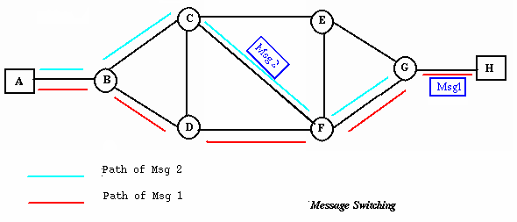
Message Switching
A message-switching node is typically a general-purpose computer. The device needs sufficient secondary-storage capacity to store the incoming messages, which could be long. A time delay is introduced using this type of scheme due to store- and-forward time, plus the time required to find the next node in the transmission path.

Slide 58
Message Switching
Advantages:
  Channel efficiency can be greater compared to circuit-switched systems, because more devices are sharing the channel.
  Traffic congestion can be reduced, because messages may be temporarily stored in route.
  Message priorities can be established due to store-and-forward technique.
  Message broadcasting can be achieved with the use of broadcast address appended in the message.

Slide 59
Message Switching
Disadvantages
  Message switching is not compatible with interactive applications.
  Store-and-forward devices are expensive, because they must have large disks to hold potentially long messages.

Slide 60
8-4 STRUCTURE OF A SWITCH
We use switches in circuit-switched and packet-switched networks. In this section, we discuss the structures of the switches used in each type of network.
Topics discussed in this section:
Structure of Circuit Switches
Structure of Packet Switches

Slide 61
Structure of Circuit Switches
Circuit switching today can use either of two technologies: the space-division switch or the time-division switch.
Space-Division Switch
In space-division switching, the paths in the circuit are separated from one another spatially. This technology was originally designed for use in analog networks but is used currently in both analog and digital networks.
Crossbar Switch
A crossbar switch connects n inputs to m outputs in a grid, using electronic microswitches (transistors) at each crosspoint (Figure 8.17). The major limitation of this design is the number of crosspoints required. To connect n inputs to m outputs using a crossbar switch requires n x m crosspoints.
For example, to connect 1000 inputs to 1000 outputs requires a switch with 1,000,000 crosspoints. A crossbar with this number of crosspoints is impractical.
Such a switch is also inefficient because statistics show that, in practice, fewer than 25 percent of the crosspoints are in use at any given time. The rest are idle.

Slide 62

Figure 8.17 Crossbar switch with three inputs and four outputs

Slide 63
Multistage Switch
Multistage Switch
The solution to the limitations of the crossbar switch is the multistage switch, which combines crossbar switches in several (normally three) stages, as shown in Figure 8.18.
In a single crossbar switch, only one row or column (one path) is active for any connection. So we need N x N crosspoints. If we can allow multiple paths inside the switch, we can decrease the number of crosspoints. Each crosspoint in the middle stage can be accessed by multiple crosspoints in the first or third stage.

Slide 64
Multistage Switch
To design a three-stage switch, we follow these steps:
1. We divide the N input lines into groups, each of n lines. For each group, we use one crossbar of size n x k, where k is the number of crossbars in the middle stage.
In other words, the first stage has N/n crossbars of n x k crosspoints.
2. We use k crossbars, each of size (N/n) x (N/n) in the middle stage.
3. We use N/n crossbars, each of size k x n at the third stage.
We can calculate the total number of crosspoints as follows:
N/n (nx k) + k(N/n x N/n) + N/n(k x n) = 2kN + k(N/n)2
In a three-stage switch, the total number of crosspoints is
2kN +k(N/n)2

Slide 65

Figure 8.18 Multistage switch

Slide 66
Note
In a three-stage switch, the total
number of crosspoints is
2kN + k(N/n)²
which is much smaller than the number of crosspoints in a single-stage switch (N²).

Slide 67
Example 8.3
Design a three-stage, 200 × 200 switch (N = 200) with
k = 4 and n = 20.
Solution
In the first stage we have N/n or 10 crossbars, each of size 20 × 4. In the second stage, we have 4 crossbars, each of size 10 × 10. In the third stage, we have 10 crossbars, each of size 4 × 20. The total number of crosspoints is 2kN + k(N/n)², or 2000 crosspoints. This is 5 percent of the number of crosspoints in a single-stage switch (200 × 200 = 40,000).

Slide 68
Note
According to the Clos criterion:
n = (N/2)^{1/2}
k > 2n – 1
Crosspoints ≥ 4N [(2N)^{1/2} – 1]

Slide 69

Figure 8.19 Time-slot interchange
Time-division switching uses time-division multiplexing (TDM) inside a switch. The most popular technology is called the time-slot interchange (TSI).

Slide 70
Time- and Space-Division Switch Combinations
The advantage of space-division switching is that it is instantaneous. Its disadvantage is the number of crosspoints required to make space-division switching acceptable in terms of blocking.
The advantage of time-division switching is that it needs no crosspoints. Its disadvantage, in the case of TSI, is that processing each connection creates delays. Each time slot must be stored by the RAM, then retrieved and passed on.
In a third option, we combine space-division and time-division technologies to take advantage of the best of both. Combining the two results in switches that are optimized both physically (the number of crosspoints) and temporally (the amount of delay). Multistage switches of this sort can be designed as time-space-time (TST)
switch.

Slide 71
Time- and Space-Division Switch Combinations
Figure 8.20 shows a simple TST switch that consists of two time stages and one space stage and has 12 inputs and 12 outputs. Instead of one time-division switch, it divides the inputs into three groups (of four inputs each) and directs them to three timeslot interchanges. The result is that the average delay is one-third of what would result from using one time-slot interchange to handle all 12 inputs.
The last stage is a mirror image of the first stage. The middle stage is a space division switch (crossbar) that connects the TSI groups to allow connectivity between all possible input and output pairs (e.g., to connect input 3 of the first group to output 7 of the second group).

Slide 72

Figure 8.20 Time-space-time switch

Slide 73
Connection-Oriented and Connectionless Services
Two basic types of services
  Connection-oriented
  Connectionless

Slide 74
Connection-Oriented Service
A connection is established first, then used, and then released when done.
Works like a pipe:
  Sender pushes data in at one end
  Receiver takes them out, often in the same order, at the other end
Analogy
  Telephone system

Slide 75
Connectionless Service
No need to set up a connection first
Each message carrying full destination address is routed independently of others
  No guarantees on the order
Analogy
  Postal system

Slide 76
Connection-oriented versus Connectionless
Connection-oriented
  Setup data transfer ahead of time (through handshaking)
  Internet’s connection-oriented service is TCP (Transmission Control Protocol). It provides
    reliable, in-order byte delivery
    flow control
    congestion control.
  Applications using TCP: Email (SMTP), web browsing (HTTP), and file transfer (FTP)

Slide 77
Connection-oriented versus Connectionless
Connectionless
  Internet’s connectionless service is UDP (User Datagram Protocol). It provides
    unreliable data transfer
    no flow control
    no congestion control
  Applications using UDP: streaming media, video conferencing, and IP telephony

Slide 78
TELEPHONE NETWORK
Telephone networks use circuit switching. The telephone network had its beginnings in the late 1800s. The entire network, which is referred to as the Plain Old Telephone System (POTS) or Public Switched Telephone Network (PSTN), was originally an analog system using analog signals to transmit voice.

Slide 79
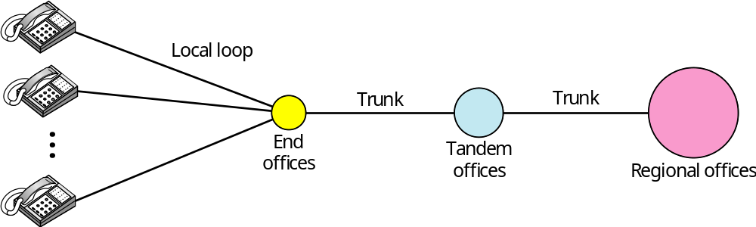
Figure 9.1 A telephone system
The telephone network, as shown in Figure 9.1, is made of three major components: local loops, trunks, and switching offices. The telephone network has several levels of switching offices such as end offices, tandem offices, and regional offices.

Slide 80
A telephone system
Local Loops
One component of the telephone network is the local loop, a twisted-pair cable that connects the subscriber telephone to the nearest end office or local central office.
The local loop, when used for voice, has a bandwidth of 4000 Hz (4 kHz). It is interesting to examine the telephone number associated with each local loop. The first three digits of a local telephone number define the office, and the next four digits define the local loop number.
Trunks
Trunks are transmission media that handle the communication between offices. A trunk normally handles hundreds or thousands of connections through multiplexing. Transmission is usually through optical fibers or satellite links.
Switching Offices
To avoid having a permanent physical link between any two subscribers, the telephone company has switches located in a switching office. A switch connects several local loops or trunks and allows a connection between different subscribers.

Slide 81
A telephone system
Local-Access Transport Areas (LATAs).
A LATA can be a small or large metropolitan area. A small state may have one single LATA; a large state may have several LATAs. A LATA boundary may overlap the boundary of a state; part of a LATA can be in one state, part in another state.
Intra-LATA Services
The services offered by the common carriers (telephone companies) inside a LATA are called intra-LATA services. The carrier that handles these services is called a local exchange carrier (LEC).
Inter-LATA Services
The services between LATAs are handled by interexchange carriers (IXCs). These carriers, sometimes called long-distance companies, provide communication services between two customers in different LATAs.

Slide 82
Note
Intra-LATA services are provided by local exchange carriers.
Since 1996, there are two
types of LECs: incumbent local exchange carriers and competitive
local exchange carriers.

Slide 83
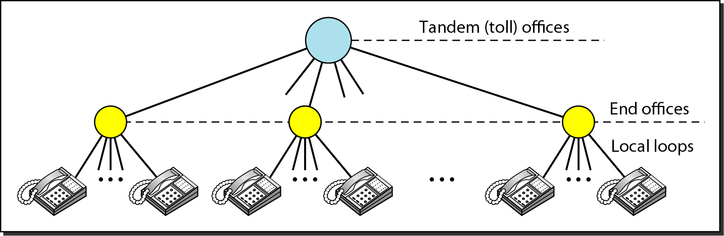
Figure 9.2 Switching offices in a LATA

Slide 84
A telephone system
Points of Presence
As we discussed, intra-LATA services can be provided by several LECs (one ILEC and possibly more than one CLEC). We also said that inter-LATA services can be provided by several IXCs. How do these carriers interact with one another? The answer is, via a switching office called a point of presence (POP). Each IXC that wants to provide inter LATA services in a LATA must have a POP in that LATA. The LECs that provide services inside the LATA must provide connections so that every subscriber can have access to all POPs. Figure 9.3 illustrates the concept.
A subscriber who needs to make a connection with another subscriber is connected first to an end switch and then, either directly or through a tandem switch, to a POP. The call now goes from the POP of an IXC (the one the subscriber has chosen) in the source LATA to the POP of the same IXC in the destination LATA. The call is passed through the toll office of the IXC and is carried through the network provided by the IXC.

Slide 85
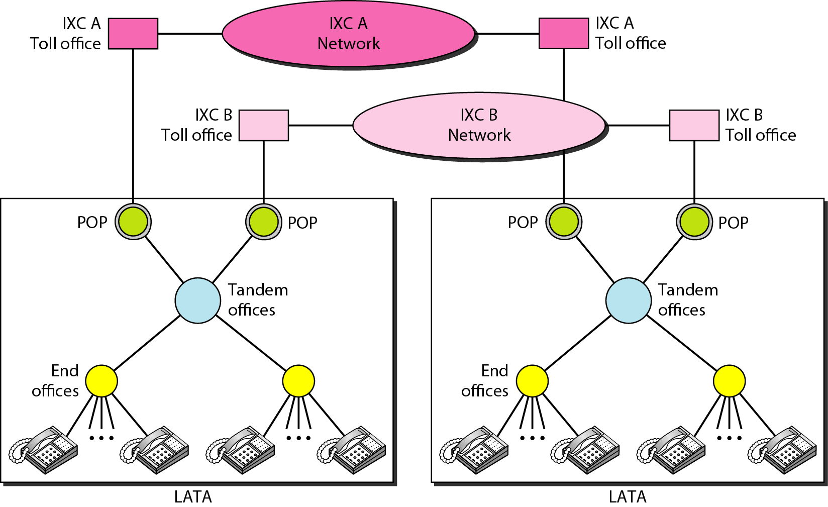
Figure 9.3 Point of presences (POPs)

Slide 86
A telephone network today can be thought of as two networks: a signaling network and a data transfer network.
The tasks of data transfer and signaling are separated in modern telephone networks: data transfer is done by one network, signaling by another.
Although the two networks are separate, this does not mean that there are separate physical links everywhere; the two networks may use separate channels of the same link in parts of the system.
Signaling
The telephone network, at its beginning, used a circuit-switched network with dedicated links (multiplexing had not yet been invented) to transfer voice communication. a circuit-switched network needs the setup and teardown phases to establish and terminate paths between the two communicating parties. In the beginning, this task was performed by human operators.
As the same circuit can be used for both signaling and voice communication. This type of signaling is called in-band signaling .

Slide 87
Later, the signaling system became automatic. Rotary telephones were invented that sent a digital signal defining each digit in a multi digit telephone number. The switches in the telephone companies used the digital signals to create a connection between the caller and the called parties.
Both in-band and out-of-band signaling were used. In out-of-band signaling, a portion of the voice channel bandwidth was used for signaling; the voice bandwidth and the signaling bandwidth were separate.
The signaling system was required to perform tasks such as
1. Providing dial tone, ring tone, and busy tone
2. Transferring telephone numbers between offices
3. Maintaining and monitoring the call
4. Keeping billing information
5. Maintaining and monitoring the status of the telephone network equipment
6. Providing other functions such as caller ID, voice mail, and so on

Slide 88
Data Transfer Network
The data transfer network that can carry multimedia information today is, for the most part, a circuit-switched network, although it can also be a packet-switched network.
Signaling Network
The signaling network, is a packet-switched network. involving the layers similar to those in the OSI model or Internet model the information needed to convey a telephone address can easily be encapsulated in a packet with all the error control and addressing
information. Figure 9.4 shows a simplified situation of a telephone network in which the two networks are separated.
The user telephone or computer is connected to the signal points (SPs). The link between the telephone set and SP is common for the two networks. The signaling network uses nodes called signal transport ports (STPs) that receive and forward signaling messages. The signaling network also includes a service control point (SCP) that controls the whole operation of the network.

Slide 89
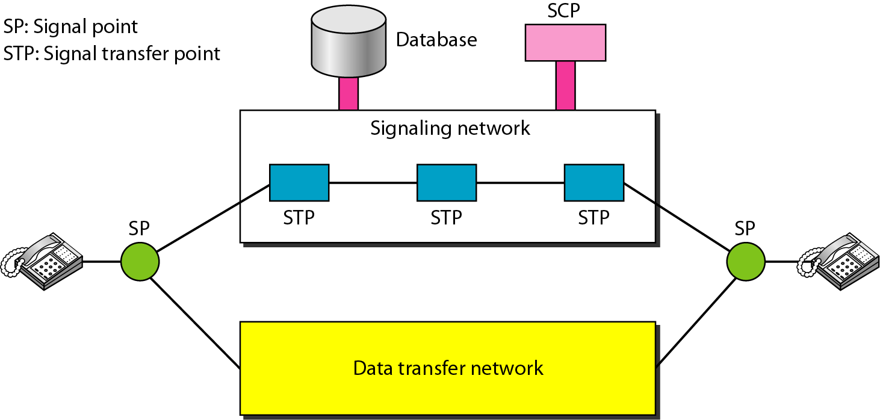
Figure 9.4 Data transfer and signaling networks

Slide 90
DIAL-UP MODEMS
Traditional telephone lines can carry frequencies between 300 and 3300 Hz, giving them a bandwidth of 3000 Hz. All this range is used for transmitting voice, where a great deal of interference and distortion can be accepted without loss of intelligibility.
The term modem is a composite word that refers to the two functional entities that make up the device: a signal modulator and a signal demodulator. A modulator creates a bandpass analog signal from binary data. A demodulator recovers the binary data from the modulated signal.

Slide 91
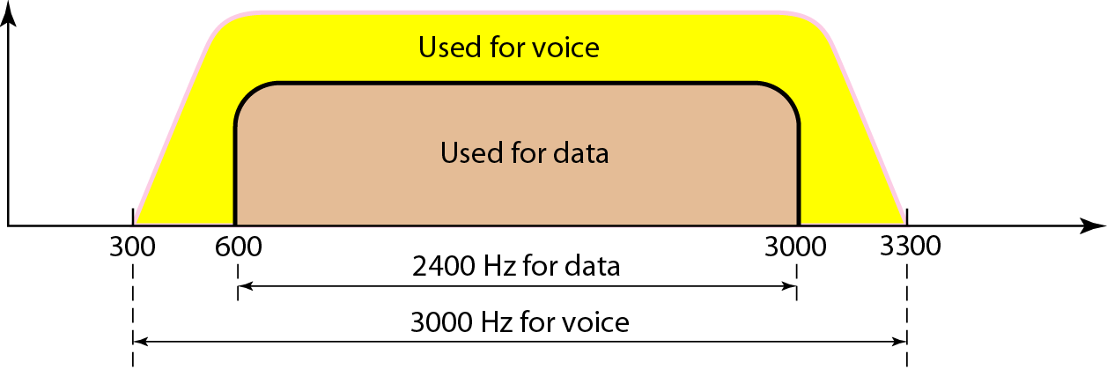
Figure 9.6 Telephone line bandwidth
300 Hz – 3300 Hz
For voice the entire range is used because some distortion and noise can be tolerated
But for data, for integrity of data, edges of this range are not used. The range used for data is 600 Hz – 3000 Hz = 2400 Hz BW.

Slide 92
Note
Modem
stands for modulator/demodulator.
Modulator : converts the binary data into band-pass analog signal.
Demodulator : recovers the binary data from the modulated signal

Slide 93
Few terms
Bit rate : number of bits transmitted per second.
Baud rate : number of signal units (or samples) transmitted per second.
Bit rate = Baud rate x number of data bits per sample.

Slide 94
Some traditional modem standards
Earlier modems used the QAM schemes. For QAM schemes the baud rate is equal to the bandwidth. Hence for a telephone line of 2400 Hz bw, baud rate of 2400 was used.
V.32 : 4 data bits + 1 error bit : 2400 x 4 = 9600 bps
V.32bis : 6 data bits + 1 error bit : 2400 x 6 = 14,400 bps
V.34 : 12 data bits : 2400 x 12 = 28,800 bps
V.34bis : 14 data bits : 2400 x 14 = 33,600 bps

Slide 95
Limitations of traditional modems
When the analog signal is digitized at the telephone company switching station noise is introduced in the signal. Hence the data rate is limited according to the Shannon’s capacity.
In traditional modems, data exchange is between two computers A and B,( through the digital telephone network.), Hence this sampling exists in both the directions.
Thus the maximum data rate is 33.6 kbps in either direction.

Slide 96
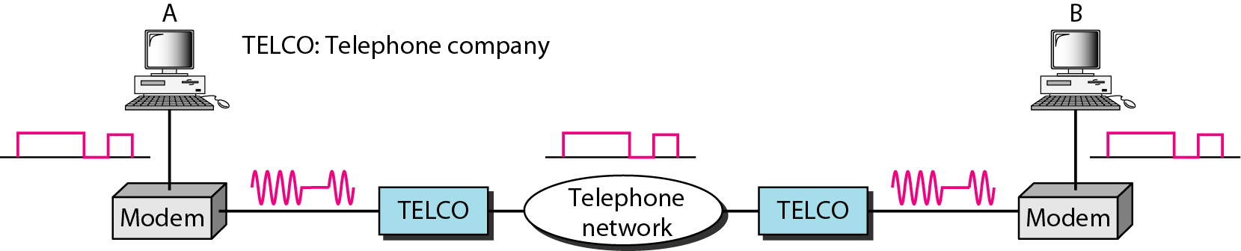
Figure 9.7 Modulation/demodulation

Slide 97
Some faster modems
V.90 offers 56kbps download and 33.6 kbps upload speeds.
This is possible because communication today is via ISPs (Internet Service Providers). We still use modem to upload and download. But, in uploading, the analog signal must be sampled at the switching stations which means the data rate for uploading is limited to 33.6 as earlier. But, there is no sampling in the downloading, hence no noise , hence no Shannon’s limit.

Slide 98
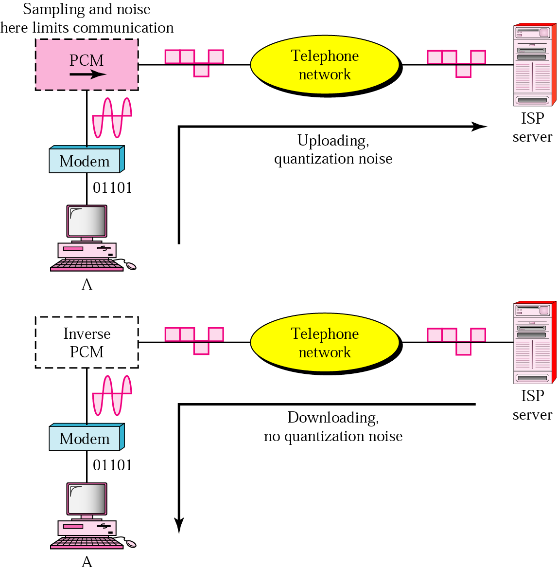
56K modems

Slide 99
The 56Kbps speed for downloading in V.90
The telephone companies (at their switching offices) generate 8000 samples per second with 8 bits per sample. One bit is for control giving a data rate of 8000 x 7 = 56Kbps

Slide 100
The V.92
Adjusts its speed and depending upon the noise present can even upload at 48kbps.
Download is at 56kpbs.

Slide 101
DIGITAL SUBSCRIBER LINE
After traditional modems reached their peak data rate, telephone companies developed another technology, DSL, to provide higher-speed access to the Internet. Digital subscriber line (DSL) technology is one of the most promising for supporting high-speed digital communication over the existing local loops.
Topics discussed in this section:
ADSL
ADSL Lite
HDSL
SDSL
VDSL

Slide 102
ADSL
The first technology in the set is asymmetric DSL (ADSL). ADSL, like a 56K modem, provides higher speed (bit rate) in the downstream direction (from the Internet to the resident) than in the upstream direction (from the resident to the Internet). That is the reason it is called asymmetric.
Unlike the asymmetry in 56K modems, the designers of ADSL specifically divided the available bandwidth of the local loop unevenly for the residential customer. The service is not suitable for business customers who need a large bandwidth in both directions.
ADSL uses a frequency spectrum of 1.1 MHz. Divides it into 256 channels each of size roughly 4312.5 Hz.
Channel 0 : POTS
Channels 1-5 ; guard band between voice and data
Two for control channels, one for downstream and one for upstream
Remaining are partitioned between upstream and downstream : depends on the service provider; usually it is asymmetric giving 80-90% for download and remaining for upstream – hence the word Asymmetric

Slide 103
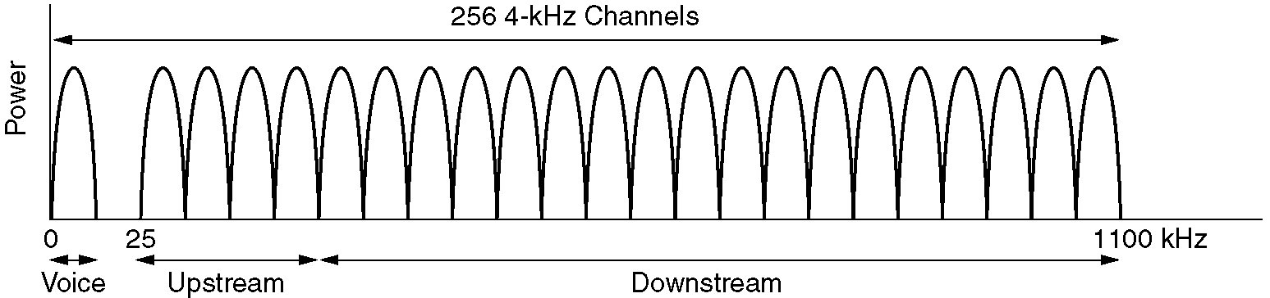
Digital Subscriber Lines
Operation of ADSL using discrete multitone modulation.

Slide 104
Note
ADSL is an adaptive technology.
The system uses a data rate
based on the condition of
the local loop line.

Slide 105
Discrete Multitone Technique
The modulation technique that has become standard for ADSL is called the discrete multitone technique (DMT) which combines QAM and FDM. There is no set way that the bandwidth of a system is divided. Each system can decide on its bandwidth division.
Figure 9.10 shows how the bandwidth can be divided into the following:
Voice: Channel 0 is reserved for voice communication.
Idle: Channels 1 to 5 are not used and provide a gap between voice and data communication.
Upstream data and control: Channels 6 to 30 (25 channels) are used for upstream data transfer and control. One channel is for control, and 24 channels are for data transfer.
Downstream data and control: Channels 31 to 255 (225 channels) are used for downstream data transfer and control. One channel is for control, and 224 channels are for data.

Slide 106
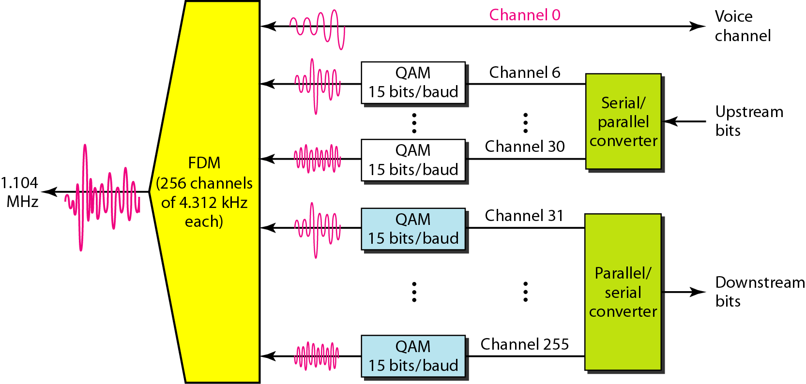
Figure 9.10 Discrete multitone technique

Slide 107
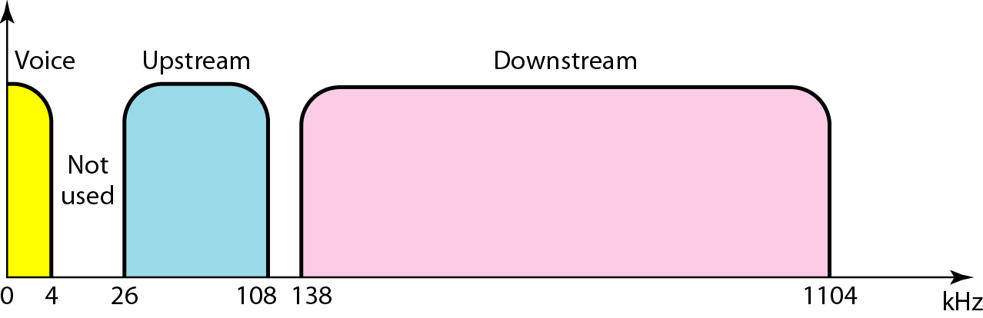
Figure 9.11 Bandwidth division in ADSL

Slide 108
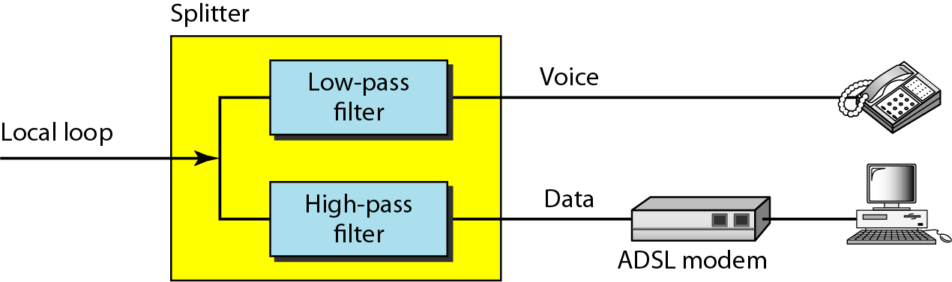
Figure 9.12 ADSL modem

Slide 109
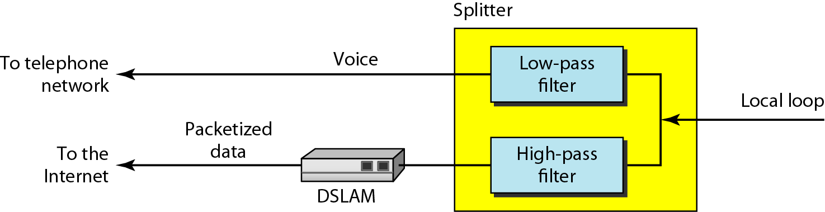
Figure 9.13 DSLAM

Slide 110
ADSL Lite
The installation of splitters at the border of the premises and the new wiring for the data line can be expensive and impractical enough to dissuade most subscribers.
A new version of ADSL technology called ADSL Lite (or Universal ADSL or splitterless ADSL) is available for these subscribers.
This technology allows an ASDL Lite modem to be plugged directly into a telephone jack and connected to the computer. The splitting is
done at the telephone company. ADSL Lite uses 256 DMT carriers with 8-bit modulation (instead of 15-bit).
It can provide a maximum downstream data rate of 1.5 Mbps and an upstream data rate of 512 kbps.

Slide 111
HDSL
The high-bit-rate digital subscriber line (HDSL) was designed as an alternative to the T-1 line (1.544 Mbps). The T-1line uses alternate mark inversion (AMI) encoding, which is very susceptible to attenuation at high frequencies. This limits the length of a T-1 line to 3200 ft (1 km). For longer distances, a repeater is necessary, which means increased costs.
HDSL uses 2B1Q encoding, which is less susceptible to attenuation.
A data rate of 1.544 Mbps (sometimes up to 2 Mbps) can be achieved without repeaters up to a distance of 12,000 ft (3.86 km). HDSL uses two twisted pairs (one pair for each direction) to achieve full-duplex transmission.

Slide 112
SDSL
The symmetric digital subscriber line (SDSL) is a one twisted-pair version of HDSL.
It provides full-duplex symmetric communication supporting up to 768 kbps in each direction. SDSL, which provides symmetric communication, can be considered an alternative to ADSL.

Slide 113
VDSL
The very high-bit-rate digital subscriber line (VDSL), an alternative approach that is similar to ADSL, uses coaxial, fiber-optic, or twisted-pair cable for short distances. The modulating technique is DMT. It provides a range of bit rates (25 to 55 Mbps) for upstream communication at distances of 3000 to 10,000 ft. The downstream rate is normally 3.2 Mbps

Slide 114
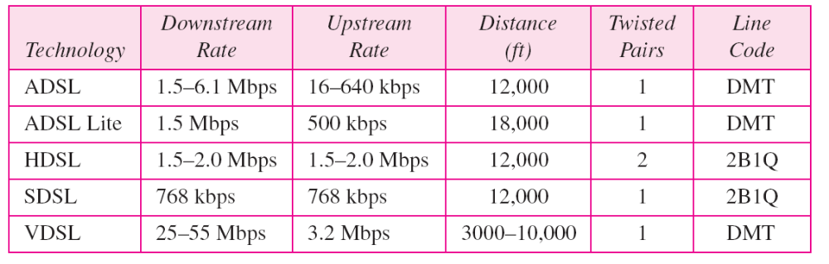
Table 9.2 Summary of DSL technologies

Slide 115
Cable broadband Vs DSL
Cable Broadband is a public network and is shared by several users, hence
  Bandwidth reduces as more users log in, and
  Less secure
ADSL is a private network ..works on leased lines from old PSTN, hence
  Dedicated bandwidth, and
  More secure

Slide 116
Cable broadband Vs DSL : Speeds
Can’t distinguish on the basis of speeds
Different companies offer different packages
Cable modem speeds vary widely. While cable modem technology can theoretically support up to about 30 Mbps, most providers offer service with between 1 Mbps and 6 Mbps bandwidth for downloads, and bandwidth between 128 Kbps and 768 Kbps for uploads.
Both take flat monthly or yearly rents

Slide 117

Network topology

Slide 118
NETWORKS
A network is a set of devices (often referred to as nodes) connected by communication links. A node can be a computer, printer, or any other device capable of sending and/or receiving data generated by other nodes on the network.
Notes:
1.#

Slide 119

Types of connections: point-to-point and multipoint
Notes:
1.#

Slide 120

Topology
Topology refers to the layout of connected devices on a network.
Here, some logical layout of topology.
oMesh oStar
oBus
oRing
oTree and Hybrid

Slide 121

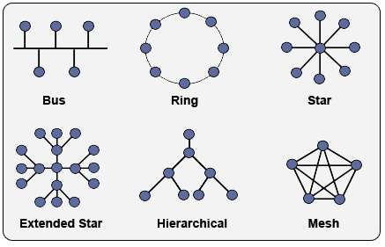
Network Topology

Slide 122

Mesh Topology
Here every device has a point to point link to every other device.
Node 1 node must be connected with n-1 nodes.
A fully connected mesh can have n(n-1)/2 physical channels to link n devices.
It must have n-1 I/O ports.

Slide 123
Mesh Topology
Advantages:
They use dedicated links so each link can only carry its own data load. So traffic problem can be avoided.
It is robust. If any one link get damaged it cannot affect others.
It gives privacy and security.(Message travels along a dedicated link)
Fault identification and fault isolation are easy.

Slide 124
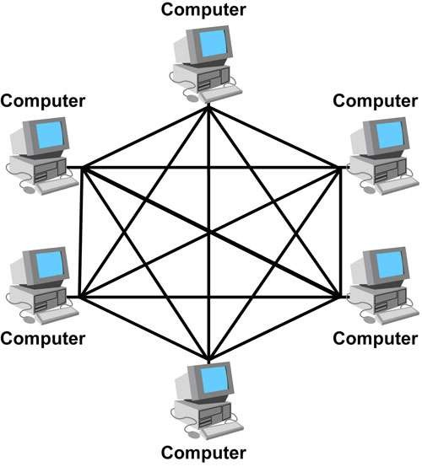
Mesh Topology

Slide 125
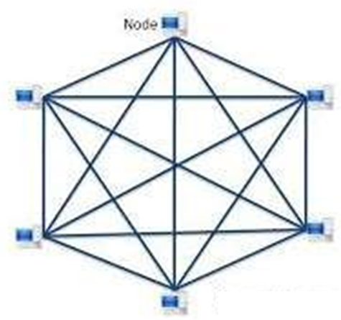
Mesh Topology

Slide 126
Mesh Topology
Disadvantages:
The amount of cabling and the number of I/O ports required are very large. Since every device is connected to each devices through dedicated links.
The sheer bulk of wiring is larger then the available space.
Hardware required to connected each device is highly expensive.

Slide 127
Mesh Topology
Applications:
Telephone Regional office.
WAN (Wide Area Network).

Slide 128


Star Topology
Here each device has a dedicated point-to-point link to the central controller called “Hub”(Act as a Exchange).
There is no direct traffic between devices.
The transmission are occurred only through the central “hub”.
When device 1 wants to send data to device 2; First sends the data to hub. Which then relays the data to the other connected device.

Slide 129

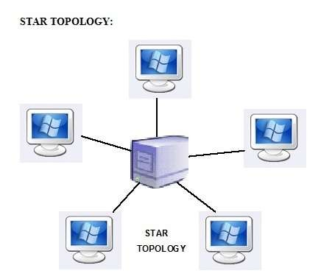
Star Topology

Slide 130
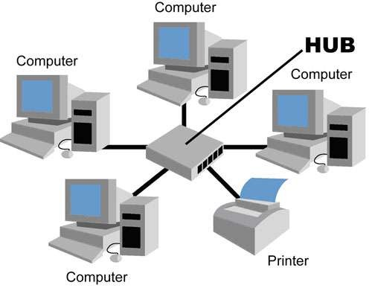
Star Topology

Slide 131
Star Topology
Advantages:
Less expensive then mesh since each device is connected only to the hub.
Installation and configuration are easy.
Less cabling is need then mesh.
Robustness.(if one link fails, only that links is affected. All other links remain active)
Easy to fault identification & to remove parts.
No distruptions to the network then connecting(or) removing devices.

Slide 132
Star Topology
Disadvantages:
Even it requires less cabling then mesh when compared with other topologies it still large.(Ring or bus).
Dependency(whole n/w dependent on one single point(hub). When it goes down. The whole system is dead.

Slide 133

Applications
Star topology used in Local Area Networks(LANs).
High speed LAN often used STAR.

Slide 134

Bus Topology
A bus topology is multipoint.
Here one long cable act as a backbone to link all the devices are connected to the backbone by drop lines and taps.
Drop line- is the connection b/w the devices and the cable.
Tap- is the splitter that cut the main link.
This allows only one device to transmit at a time.

Slide 135

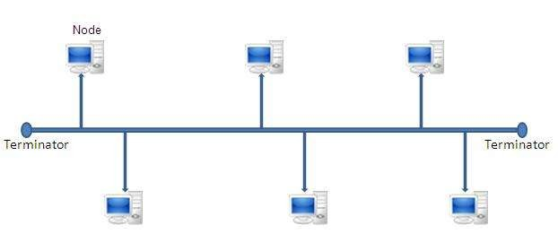
Bus Topology

Slide 136
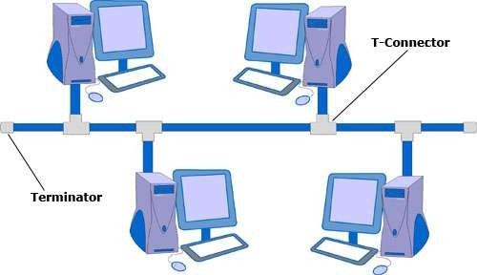
Bus Topology

Slide 137

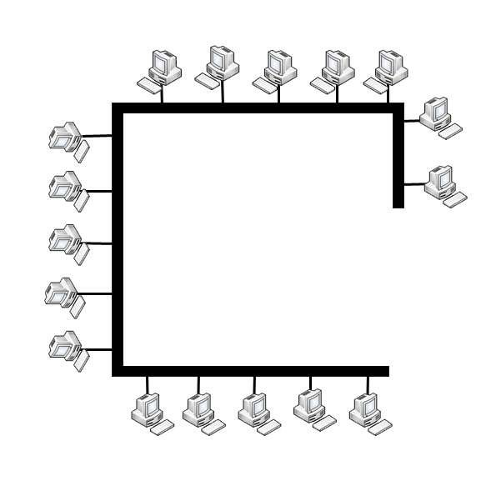
Bus Topology

Slide 138
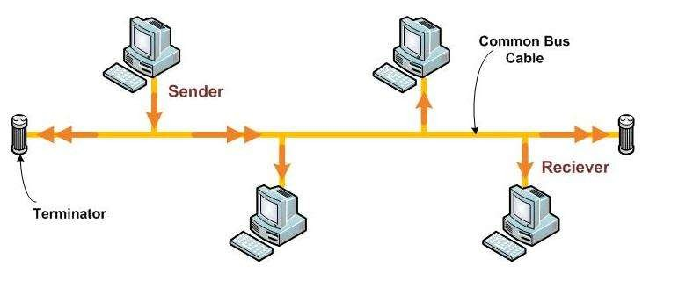
Bus Topology

Slide 139
Bus Topology
A device want to communicate with other device on the n/ws sends a broadcast message onto the wire all other devices see.
But only the intended devices accepts and process the message.

Slide 140

Bus Topology
Advantages:
Ease of installation
Less cabling
Disadvantages:
Difficult reconfiguration and fault isolation.
Difficult to add new devices.
Signal reflection at top can degradation in quality.
If any fault in backbone can stops all transmission.

Slide 141
Bus Topology
Applications:
Most computer motherboard.

Slide 142

Ring Topology
Here each device has a dedicated connection with two devices on either side.
The signal is passed in one direction from device to device until it reaches the destination and each device have repeater.
When one device received signals instead of intended another device, its repeater then regenerates the data and passes them along.
To add or delete a device requires changing only two connections.

Slide 143

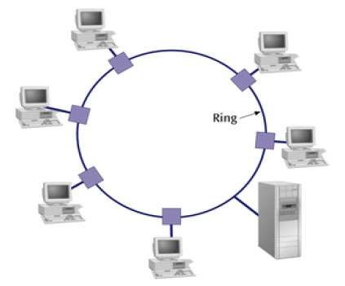
Ring Topology

Slide 144
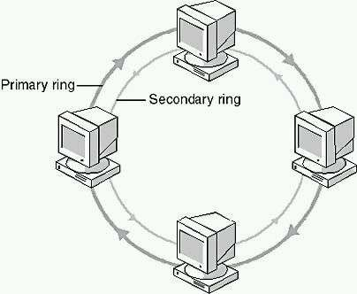
Ring Topology

Slide 145

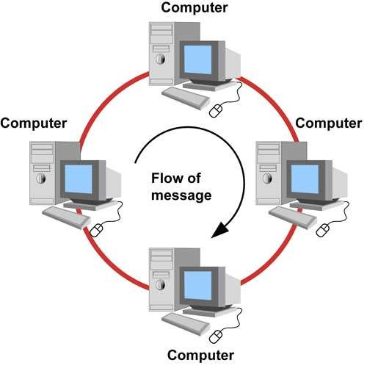
Ring Topology

Slide 146
Ring Topology
Advantages:
Easy to install.
Easy to reconfigure.
Fault identification is easy.
Disadvantages:
Unidirectional traffic.
Break in a single ring can break entire network.

Slide 147
Ring Topology
Applications:
Ring topologies are found in some office buildings or school campuses.
Today high speed LANs made this topology less popular.

Slide 148


Tree Topology
Alternatively referred to as a star bus topology.
Tree topology is one of the most common network setups that is similar to a bus topology and a star topology.
A tree topology connects multiple star networks to other star networks. Below is a visual example of a simple computer setup on a network using the star topology.

Slide 149
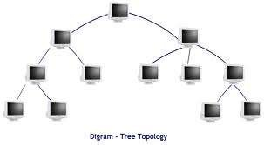
Tree Topology

Slide 150

Hybrid Topology
A network which contain all type of physical structure and connected under a single backbone channel.

Slide 151

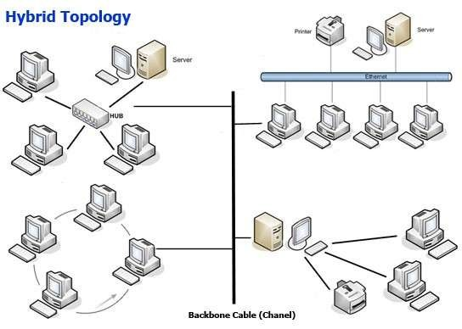
Hybrid Topology
a

Slide 152


Considerations for choosing topology
Money-Bus n/w may be the least expensive way to install a n/w.
Length-of cable needed- the linear bus n/w uses shorter lengths of cable.
Future growth-with star topology, expending a n/w is easily done by adding another devices.
Cable type-most common used cable in commercial organization is twisted pair. Which often used with star topologies.

Slide 153
Full mesh topology is theoretically the best since every device is connected to every other device.(thus maximizing speed and security. however, it quite expensive to install)
Next best would be tree topology, which is basically a connection of star.

